Slide 1
CS 447/647
Filesystem(s)
Notes:
A file system is an organization of data and metadata on a storage device.

Slide 2
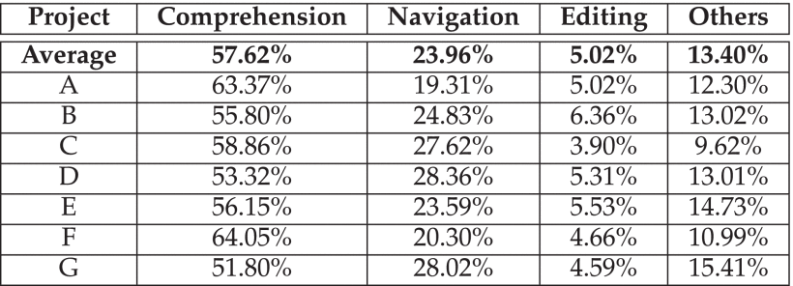
Measuring Program Comprehension: A Large-Scale Field Study with Professionals https://ieeexplore-ieee-org.unr.idm.oclc.org/document/7997917
“During software development and maintenance, developers spend a considerable amount of time on program comprehension activities.”

Slide 3
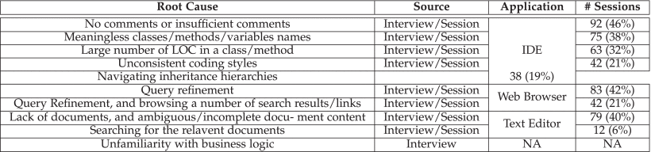

Slide 4
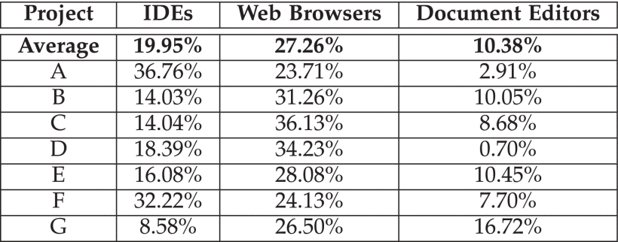

Slide 5
References
Love, Robert. Linux Kernel Development. Addison-Wesley, 2015.
Nemeth, Evi, et al. UNIX and LINUX System: Administration Handbook. Addison-Wesley/Pearson, 2018.

Slide 6
Overview
Philosophy
Virtual File System
File Types

Slide 7
Intro
Processes - /proc
Audio devices, Graphics Cards- /dev
Kernel data structures and tuning parameters - /sys
Interprocess communication channels - /run (sockets)
Directories
cat /dev/urandom > /dev/dsp #Old
cat /dev/urandom | tr -dc "0-9a-z" | aplay #New
Notes:
What you can find on a *nix filesystem.

Slide 8
What is a filesystem?
A namespace
Organize items into a hierarchy
An API
A set of system calls for navigation and manipulation
Security Model
Protecting, hiding and sharing
An implementation
Logical Model to the hardware

Slide 9
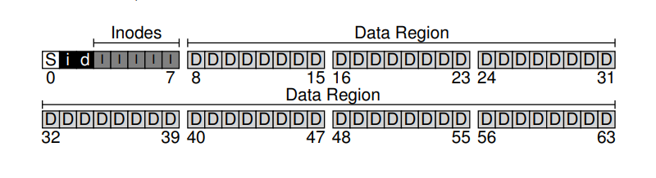

Slide 10
Filesystem Philosophy
Everything is a file
/dev/nvidia0
/proc/1
Single Tree
“/”
Files are a big bag of bytes
Streams of bytes with little metadata
Not so true with xattrs now. > 2.5 Kernel
ioctl

Slide 11
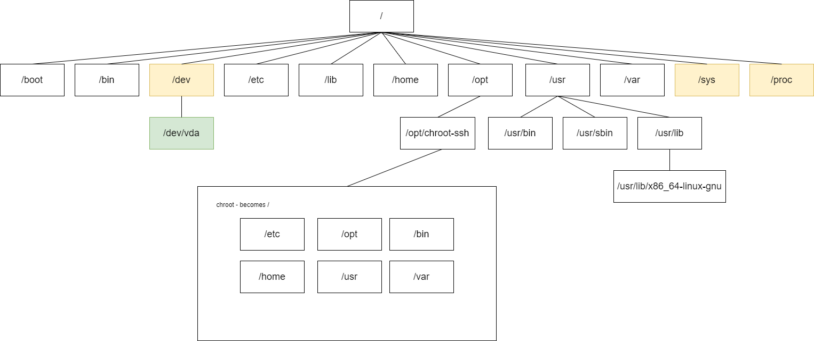
man hier
Notes:
What’s missing: proc, sys and dev

Slide 12
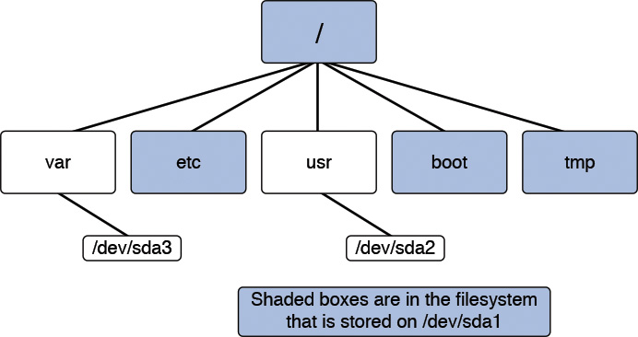

Slide 13
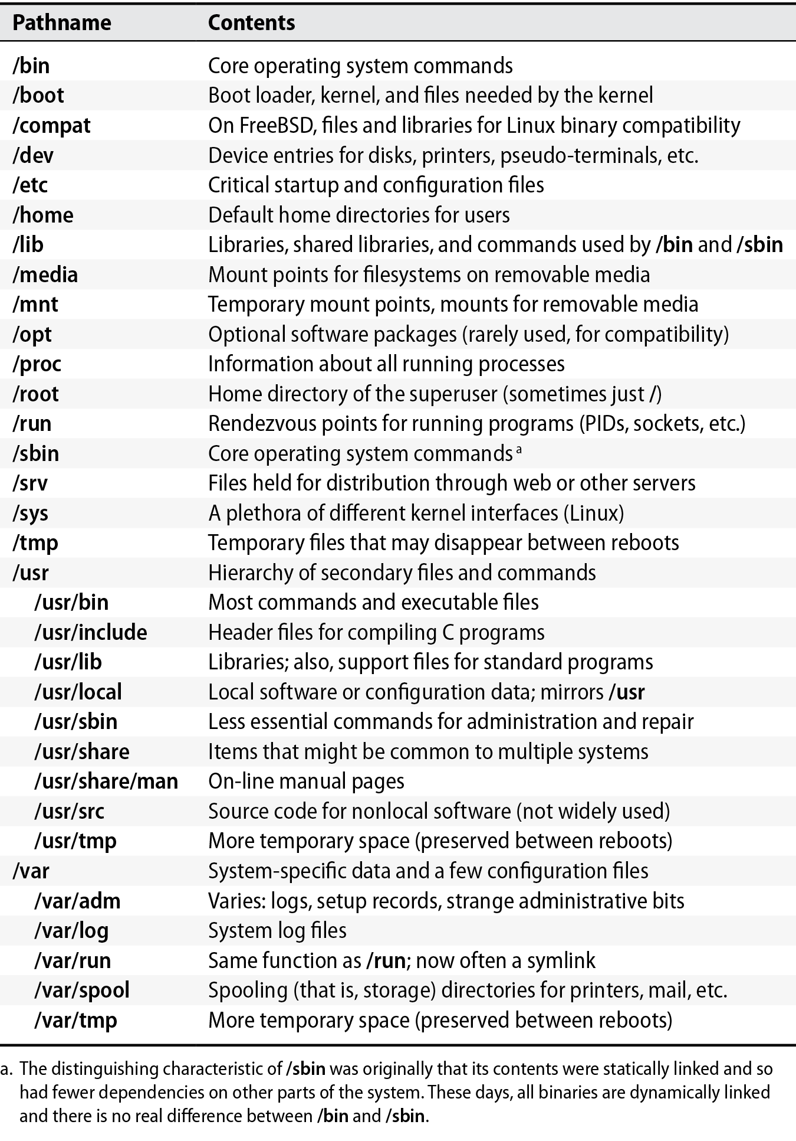

Slide 14
Size Requirements
/boot
100 MB (modern recommendation is 1 GB). Keep kernels under the 1024-cylinder limit.
swap
1 GB, depending on RAM.
/
500 MB (minimum).
/usr
4 GB. All of the executables in /usr are shared to workstations via read-only NFS.
/var
2 GB. Since log files are in their own partition, they won’t threaten system stability if the filesystem is full.
/tmp
500 MB. Since temporary files are in their own partition, they won’t threaten system stability if the filesystem is full.
/home
90 GB. This big partition takes up the vast bulk of available space, offered to users for their home directories and data.

Slide 15
Kernel Virtual File System
Subsystem that implements file and filesystem related interfaces to user-land
Almost all filesystems rely on VFS
Allows all applications to use standard *nix system system calls
open(2)
stat(2)
read(2)
write(2)
chmod(2)
Works between filesystems and devices
Notes:
It is only because modern operating systems, such as Linux, abstract access to the filesystems via a virtual interface that such interoperation and generic access is possible.

Slide 16
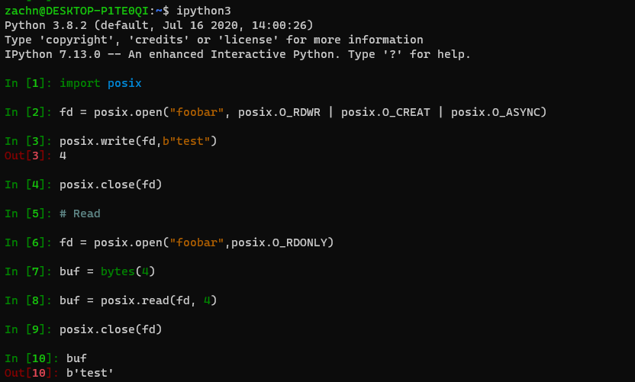
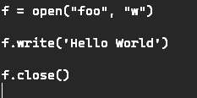

Slide 17
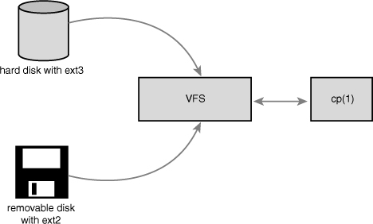
VFS
Linux Kernel Development, 3rd Edition

Slide 18
VFS - Abstraction Layer
Abstracts the low-level filesystem interface (ext{2,3,4})
Allows different filesystems to interact
Compression
Encryption
ZFS
Biased to Unix-style filesystems
Support for NTFS, FAT, exFAT, SAMBA

Slide 19
VFS - Abstraction Layer
Defines interfaces and data structures
VFS Defines
How to open files
This is what a directory is
Results in support for many types of file systems easily
All of these filesystems implement the VFS interfaces and structures
The Kernel doesn’t need to know the underlying implementation
Notes:
that all low-level filesystems must support

Slide 20
write(2) function - man 2 write
ret = write(file_descriptor, buffer, length);
Notes:
VFS file write function
write() writes up to count bytes from the buffer starting at buf to the file referred to by the file descriptor
fd.

Slide 21
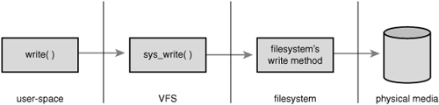
Linux Kernel Development, 3rd Edition

Slide 22
*nix Filesystems
Filesystem abstractions
Files - Ordered string of bytes, human readable name
Directory Entries - analogous to a folder of files. Each part of a path is a directory entry (dentry)
Inodes - represents an object within the file system
Mount Points - superblock
Filesystem is hierarchical storage adhering to a structure

Slide 23
VFS superblock
A superblock represents a filesystem
Defined in <linux/fs.h> struct super_block
Properties
Mount point
Block size
Quotas
Mount flags (rw, ro, sync, async)
Filesystem type
Notes:
It includes the necessary information to manage the file system during operation

Slide 24
VFS inode
An inode stores metadata about a file
Defined in <linux/fs.h> struct inode
Properties
Bytes consumed
User ID
Group ID
Last access time
Last modify time
Last change time
Permissions
find . -name "*" -printf "%u %p %k \n"

Slide 25
VFS dentry
Parts of a path associated with an inode
/bin/vim -> / bin / vim
Properties
Parent
Name
inode
Subdirectories

Slide 26
VFS file
In-memory representation of a file
Content has no inherit structure
Defined in <linux/fs.h> struct inode
Properties
dentry
mode
Functions
Read
Write
Open
Close
Lock

Slide 27
Filesystems in the kernel
62 total
fscache reiserfs ext4 ext2 jbd2 cramfs squashfs ramfs hugetlbfs coda
minix fat bfs isofs hfsplus hfs ecryptfs freevxfs nfs exportfs cifs
ntfs
ufs
fuse
overlayfs
jfs
xfs
autofs
tmpfs

Slide 28
File Types

Slide 29
Regular files
Bag of bytes
No structure
Text, binary, executables, shared libraries

Slide 30
Portable Network Graphic
Image format
Designed for the WWW
25 years old
Made up of Chunks
Can be streamed
Designed to be simple, legally unencumbered, compressed, interchangeable, flexible and robust.
Pronounced “ping”

Slide 31
PNG Binary Format
Self describing chunks
Starts with a file signature
b'\x89PNG\r\n\x1a\n'
\r\n - Return, Newline
\x1a - CTRL-Z, DOS SUB character, EOF character. Hides the binary data.

Slide 32
PNG Chunks
Typical Image
Signature
IHDR
IDAT
IEND
Chunks: gAMA, tEXT, tRNS, cHRM, sRGB, iCCP, bKGB, etc.

Slide 33
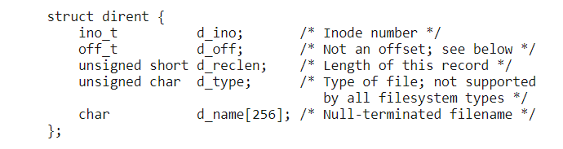
Directories
A file that points to other files. Limited to 255 characters.
Each file is a struct dirent
dirent stream is read with getdents64(2) or readdir(3)

Slide 34
Files in a directory
d_type
DT_BLK This is a block device. DT_CHR This is a character device. DT_DIR This is a directory. DT_FIFO This is a named pipe (FIFO). DT_LNK This is a symbolic link. DT_REG This is a regular file. DT_SOCK This is a UNIX domain socket. DT_UNKNOWN The file type could not be determined.

Slide 35
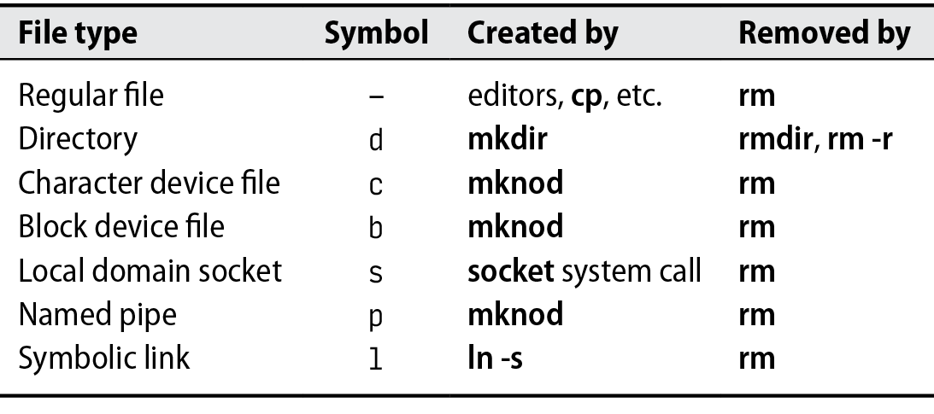
File Types
ls -lha /dev find . -type d -exec file {} \;

Slide 36
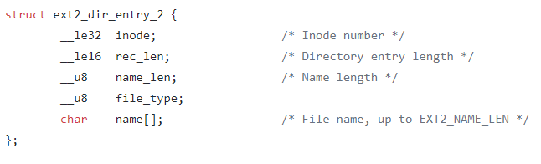
ext2 implementation

Slide 37
Character device file
Made with mknod(1)
Allows you to communicate with hardware
GPUs
Serial ports - /dev/ttyUSB0
Audio
/dev/random
i2c
Major and Minor numbers, 252:0
find /dev -type c
Notes:
The major number identifies the driver associated with the device.
The kernel uses the major number at open time to dispatch execution to the appropriate driver.
The minor number is used only by the driver specified by the major number; other parts of the kernel don’t use it, and merely pass it along to the driver. It is common for a driver to control several devices (as shown in the listing); the minor number provides a way for the driver to differentiate among them.

Slide 38
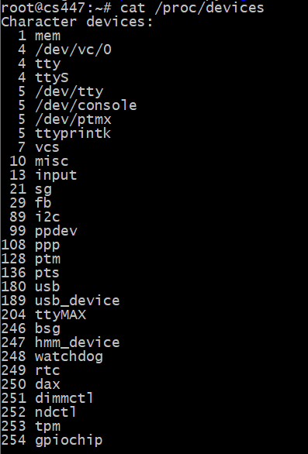

Slide 39
Block device file
Represents a block device
Storage
Similar to Character device
Writes and reads in fixed sizes. 512 bytes (default)
dd if=/dev/vda of=first_block.img count=1
find /dev -type b;

Slide 40
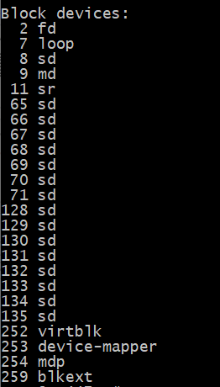

Slide 41
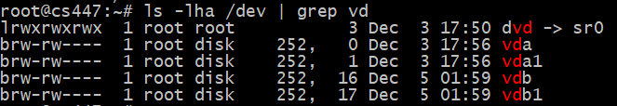

Slide 42
Local domain socket file
AKA Unix socket
Used for interprocess communication
Bi-directional
Created with the socket(2) function
bind(2) assigns an address
Filename
IP + Port
Client-Server
find /dev -type s; man 7 unix

Slide 43
Local domain socket file
What are they used for?
UWSGI - Application Container
syslog - Logging
systemd - Linux init process
SQL Databases - MySQL, PostgreSQL
Mail - postfix, dovecot, mailx, alpine
Virtualization - QEMU management interfaces
Graphical User Interfaces - Xorg, GNOME, etc.

Slide 44
Named pipe file
AKA First-In First-Out (FIFO) file
Unidirectional file for interprocess communication
Created with mknod(1)
Not used much compared to AF_UNIX or AF_INET
Blocks until read

Slide 45
Hard link
Filename is stored within the parents directory
A file can be in more than one directory
Directories “link” the file aka hardlink
Hard links are not a file type
Filesystems allow >= 1 directory entries.
Create with ln(1)
Deleted with rm(1)

Slide 46
Symbolic Link
Makes a link between files
Soft - Points to file path (dentry)
Hard - Points to inode
ln [OPTION]... [-T] TARGET LINK_NAME ln /data/file.txt /var/www/html/file.txt # Hard ln -s /data /var/www/html/data # Soft find /etc -type l; # Find symbolic links

